Slide 1
Energy, 2016, 117: 84-92.
“Prediction of residential building energy consumption: A neural network approach”
M.A. Rafe Biswas, Melvin D. Robinson, Nelson Fumo
Energy AI Track Kim Sohee

Slide 2
Contents
1. Introduction
2. Background on application of neural network models
3. Modeling approach
4. Experimental environment: TxAIRE research house
5. Results and discussion
6. Concluding remarks
7. About this study

Slide 3
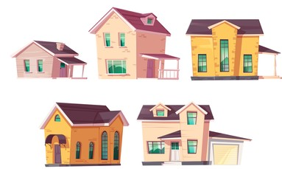
01. Introduction
Residential dwellings sector “is largely an undefined energy sink” when compared to the commercial, industrial, and transportation sectors
Contributing factors = Size, location of the living space
Small flats or apartments require less energy compared to big houses
Others that hinder energy consumption studies
Variations in building characteristics (size and number of windows)
Different types of occupant behavior (how often, long used)
Privacy issues for collecting and sharing data (occupants’ income)
High costs of sub-metering energy usage (space heating, cooling)
-1-
Notes:
Residential dwellings account for a considerable portion of the growing energy demand in the world today, yet this sector “is largely an undefined energy sink” when compared to the commercial, industrial, and transportation sectors.
In the residential sector, two such contributing factors are size and location of the living space.
For example, small flats or apartments require less energy compared to big houses since there is less thermal conditioning and heat transfer area along with lower level of human occupancy.
Other contributing factors that can hinder energy consumption studies include
variations in building characteristics such as size and number of windows,
and different types of occupant behavior such as how often and how long appliances are used.
Moreover, privacy issues for collecting and sharing data by occupants such as their income, and high costs of sub-metering energy usage of space heating and cooling are also reasons for hindrance of such studies

Slide 4
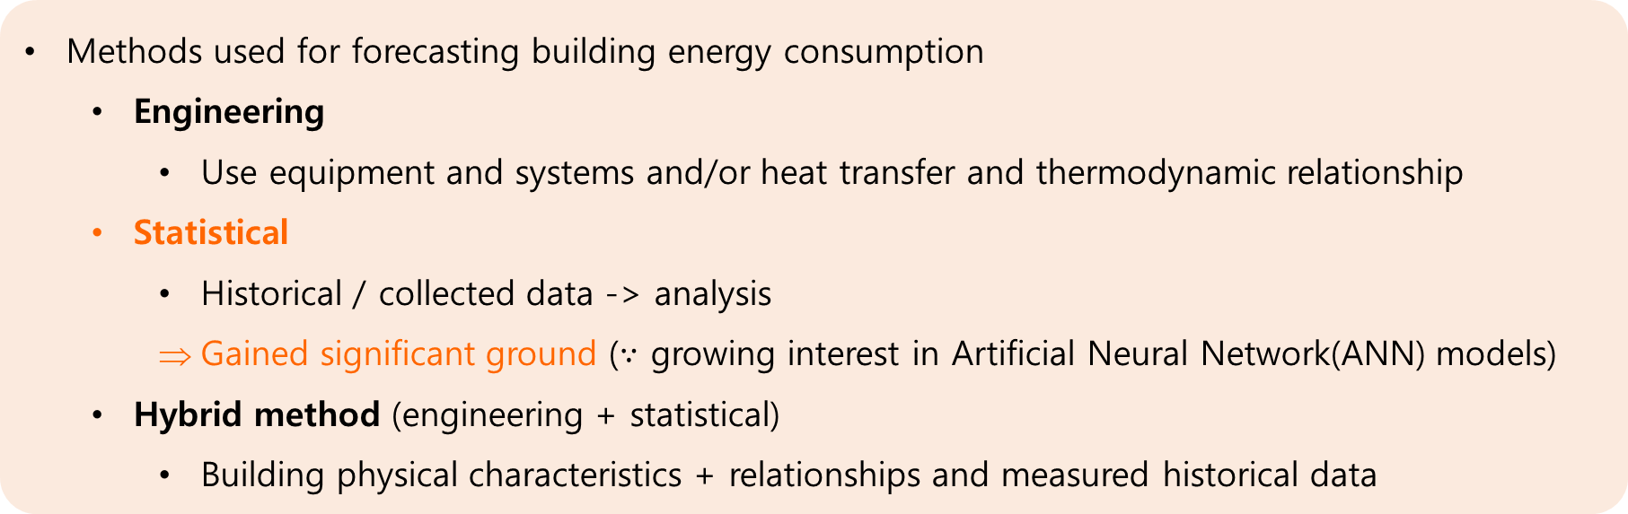
01. Introduction
Residential sector consumes transformed energy (secondary energy)
Modeling and simulation is significant in
Analysis of alternative designs of new buildings
Retrofits, to evaluate and decide on the most efficient, cost-effective selections
Methods used for forecasting building energy consumption
Engineering
Use equipment and systems and/or heat transfer and thermodynamic relationship
Statistical
Historical / collected data -> analysis
Gained significant ground ($∵$ growing interest in Artificial Neural Network(ANN) models)
Hybrid method (engineering + statistical)
Building physical characteristics + relationships and measured historical data
-2-
Notes:
The residential sector consumes transformed energy from primary power sources provided by utility companies to become suitable for use to support the living standards of occupants.
Modeling and simulation of this secondary energy consumed is significant in the analysis of alternative designs of new buildings, as well as for retrofits(개조), to evaluate and decide on the most efficient and cost-effective selections.
There are several popular methods used for forecasting building energy consumption that can be categorized into Engineering, Statistical and Hybrid methods.
Engineering methods “use equipment and systems and/or heat transfer and thermodynamic relationships to account for end-use energy consumption”
Statistical methods use historical or collected data on building energy consumption and any kind of data analysis to identify the source of the energy consumption from particular end-uses including artificial neural networks.
Hybrid approaches combine elements of engineering and statistical approaches by considering both the building physical characteristics and relationships and measured historical data
From these methods, the Statistical methods have gained significant ground with a growing interest and implementation of Artifical Neural Network (ANN) models.

Slide 5
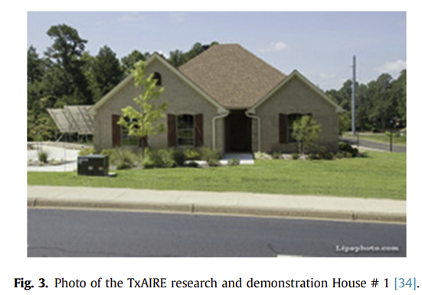
01. Introduction
Artificial Neural Network
Ability to perform nonlinear analysis
To do parallel structures that allow uninterrupted computing
To learn and train
To implement with flexibility and relative ease
Effective approach in building energy applications (than the conventional statistical models)
In this study,
Used data for an unoccupied research house
Variation in energy consumption is strongly dependent on weather
From other studies
Without influence of weather conditions, the energy use would be similar
The monthly energy consumption changes due to weather
-3-
Notes:
ANNs are very widely used artificial intelligence models due to its effective approach in building energy applications.
Moreover, prediction of residential building energy consumption fits better with NN models than with the conventional statistical models such as linear regression analysis
due to the ability to perform nonlinear analysis, to do parallel structures that allow uninterrupted computing, to learn and train, and to implement with flexibility and relative ease.
For model development in this study, data for an unoccupied research house was used
and variation in energy consumption is strongly dependent on weather.
Other studies shows that without the influence of weather conditions, the energy use on a monthly basis of a house would be similar from one month to another,
but the monthly energy consumption changes due to weather which is readily captured by a model as the proposed in this study.

Slide 6
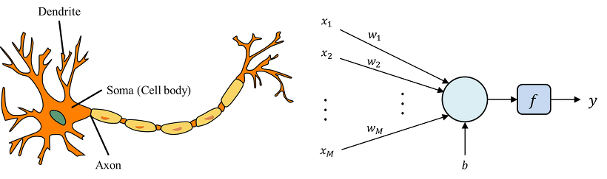
02. Background on application of neural network models
Artificial Neural Network
Developed to generalize the nervous system of a human being → mathematical models
Concept of NN analysis become wider and popular in the past 2 decades
Modeling of energy consumption in individual buildings
Ability to handle nonlinear patterns with high computing speed and high accuracy
More reliable at predicting energy system than traditional statistical approaches
-4-
Notes:
Artificial NN have been developed to generalize the nervous system of a human being into one or more mathematical models.
The concept of NN analysis was discovered 5 decades ago, but it become wider and popular in the past 2 decades.
And several researchers have demonstrated that NN can be more reliable at predicting energy consumption in a building than other traditional statistical approaches
because of their the ability to handle nonlinear patterns with high computing speed and high accuracy.

Slide 7
02. Background on application of neural network models
Building energy consumption
Vital variable, not only in scientific analysis, but also in cost analysis
High accuracy is important
Underestimation of energy consumption could lead to potential outages that can be detrimental to social and economic lifestyles
Overestimation would lead to unnecessary idle capacity and thus wasted financial resources
Several studies to develop accurate prediction of energy consumption with various type of statistical models and approaches.
Statistical model : require lot of collected data + accurate for near linear data
NN models : able to account for nonlinear data characteristics
-5-
Notes:
Building energy consumption is a vital variable , not only in scientific analysis, but also in cost analysis.
Thus, high accuracy is important in development of the energy consumption model
because underestimation of energy consumption could lead to potential outages that can be detrimental to social and economic lifestyles
while overestimation would lead to unnecessary idle capacity and thus wasted financial resources .
Therefore, there have been several studies to develop accurate prediction of energy consumption with various types of statistical models and approaches.
Since conventional statistical models require a lot of collected data and are reasonably accurate for nearlinear data,
NN models are able to account for nonlinear data characteristics that are observed in the varying electrical loads seen by utility meter readings.

Slide 8
02. Background on application of neural network models
Previous studies about NN approach to national residential building
Aydinalp et al.
Comparison of 3 methods (Engineering method (EM), conditional demand analysis (CDA) method, NN method) - used to model residential energy consumption at the national level
NN method resulted in very high prediction performance - coefficients of determination of 0.87↑
Significantly better than prediction performance of Engineering method (EM) - 0.8↓
Kialashaki and Reisel
Compares NN and multiple linear regression models - national residential sector in the United States
NN method - coefficients of determination of 0. 98↑
Multiple linear regression models - 0.95 ~ 0.98
Li and Wang
3 models (single-variable hybrid model, hybrid models + NN modeling) - forecast the electricity demand in China
The hybrid models with NN approach – maximum error 6%
The hybrid model – maximum error 9%
-6-
Notes:
There are several studies about NN methods.
It carried out a comparison of 3 methods that are currently used to model residential energy consumption at the national level. And NN method resulted in very high prediction performance
with the coefficients of determination of 0.87 and higher, which is significantly better than prediction performance of Engineering method (EM)
NN approach is not just limited to national residential building energy forecasting, but also can be applied to individual homes.
One of those studies developed an ANN model to compare with other modeling approaches.
It indicated that NN models have distinct advantages in predicting the energy consumption and the impact of socio-economic factors on energy consumption.

Slide 9
02. Background on application of neural network models
Previous study about NN approach to individual homes
Moon et al.
Developed Artificial NN model for predicting the building energy consumption – compare with other modeling approaches
3 models - predicting change in temperature, in humidity, and in Predicted Mean Vote (PMV)
The amount of energy consumed to provide heat by the heating device
In the experiment - 14.33 kWh
In simulation - 14.48 kWh
The NN method can be used to develop models with confidence to predict the energy consumption in residential houses
NN models have distinct advantages in predicting the energy consumption and the impact of socio-economic factors on energy consumption.
-7-
Notes:
NN approach is not just limited to national residential building energy forecasting, but also can be applied to individual homes.
In one of the few such studies,
Moon et al. developed an artificial NN model for predicting the building energy consumption to compare with other modeling approaches.
They developed three NN models with an identical approach for predicting change in temperature, change in humidity, and change in Predicted Mean Vote (PMV).
The amount of energy consumed to provide heat by the heating device in the experiment and simulation are 14.33 kWh and 14.48 kWh.
The difference of 1% is considered to be an acceptable amount when compared to the other studies reviewed by the authors
The findings of the comparative studies by Moon et al. indicated that the NN method can be used to develop models with confidence to predict the energy consumption in residential houses
Thus, NN models have distinct advantages in predicting the energy consumption and the impact of socio-economic factors on energy consumption.
So, this paper use NN model development for different approaches in predicting residential building energy consumption.

Slide 10
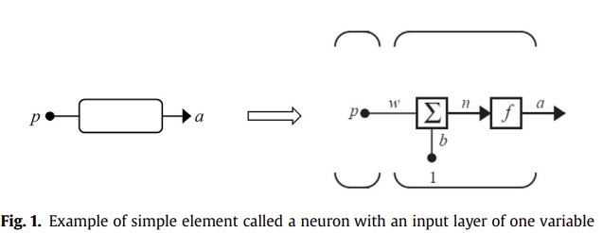


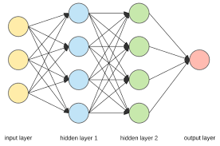
03. Modeling approach
ANN model
Neuron n
Input p
Weight function w
Bias function b
Activation function f()
Input layer : all input variables
Hidden layer (one or more)
Output layer (one or more outputs)
Number of neurons can vary for each layer independently.
-8-
Notes:
ANN model consist of simple individual element (neurons)
Each Neuron n has an input p, a weight function w and a bias function b
where f( ) is an activation function to scale or convert the neuron value into meaningful response values for further analysis. It can be a linear function, or the log sigmoid function.
A typical network consists of an input layer, one or more hidden layers where each layer has more than one neuron operating in parallel, and an output layer of one or more outputs that can be represented by the neurons
Number of neurons can vary for each layer independently.
The input layer consists of all input variables.

Slide 11
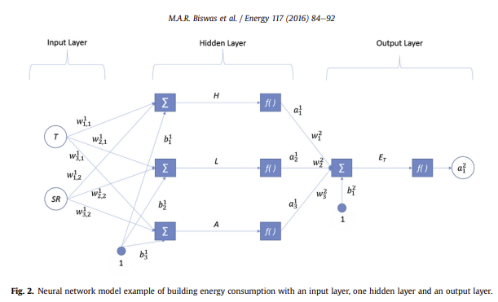

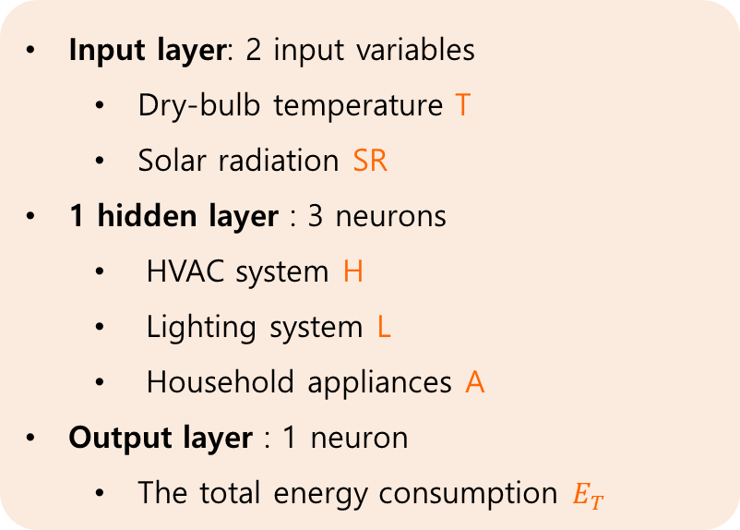
03. Modeling approach
Input layer: 2 input variables
Dry-bulb temperature T
Solar radiation SR
1 hidden layer : 3 neurons
HVAC system H
Lighting system L
Household appliances A
Output layer : 1 neuron
The total energy consumption $E_{T}$
output of previous layer = input of next layer
Each neuron is connected to all other neurons of the previous layer through a weight functions w
= Response => generated by the activation function f()
-9-
Notes:
The neurons in subsequent layers receive a neuron response of the previous layer as their inputs. Each individual neuron is connected to all other neurons of the previous layer through a weight functions w and its response (a ^layer _neuron) is generated by the activation function f( ).
The example of this picture shows a building energy consumption model that has two input variables, T and SR.
And 3 neurons in hidden layer that is H, L, and A.
The total energy consumption Et it only neuron in the output layer.
This arrangement of the NN model allows it to perform summation and apply activation functions to determine the values of a hidden or output layer.

Slide 12
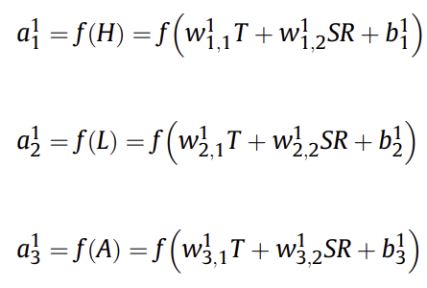



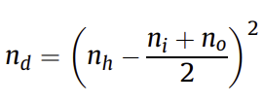
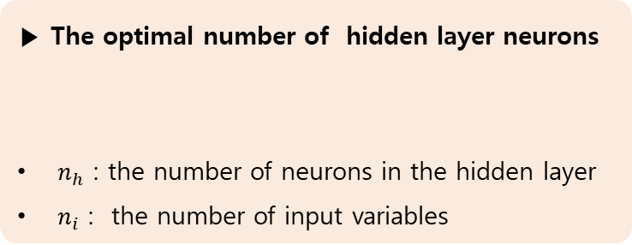
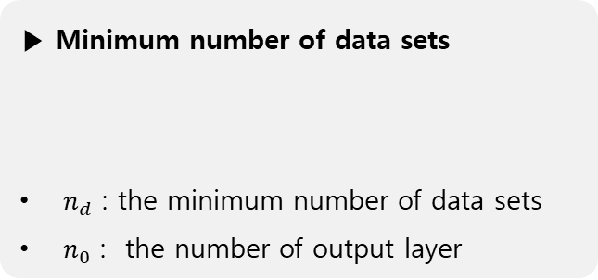
03. Modeling approach
Hidden layer
Activation function
Output
▶ The optimal number of hidden layer neurons
$n_{h}$ : the number of neurons in the hidden layer
$n_{i}$ : the number of input variables
▶ Dataset
Training
Validation
Testing
▶ Minimum number of data sets
$n_{d}$ : the minimum number of data sets
$n_{0}$ : the number of output layer
-10-
Notes:
In the example, The summation and activation in the hidden layer would be ~~
subscripts are element indices of the parameters (weight and bias), 1, 2, 3
and superscripts are the layer indices of the hidden layer. There is 1 hidden layer so it would be 1.
And activation function is also the linear function, so output response is like this, which leaves the output neuron to this.
However, the best model depends on the number of hidden layer neurons to enhance the results so an optimum number of hidden layer neurons would be based on a desired model accuracy. So the optimal number of hidden layer neurons could be established using a formula. ni is the number of input variables.
After the layer and neurons of the NN model are determined, a collected dataset is randomized and divided into 3 sets, training, validation and testing.
By this minimum number of datasets can be calculated. no is the number of neurons in output layer.
NN train weight and bias parameter with training set until all the errors are within the required tolerance. Then the validation set determine if the model is adequate.

Slide 13


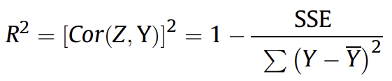
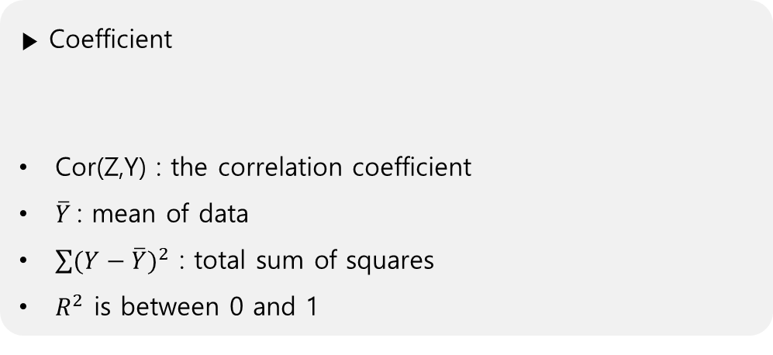
03. Modeling approach
▶ Minimizing the error value
Target (actual data values) ↔ predicted data values
Sum of squares error (SSE) :
Z = set of predicted values
Mean squared error (MSE) :
n = number of data points in the set
▶ Coefficient
Cor(Z,Y) : the correlation coefficient
$\overline{Y}$ : mean of data
$\sum{{(Y−\overline{Y})}^{2}}$ : total sum of squares
$R^{2}$ is between 0 and 1
-11-
Notes:
The model is achieved by minimizing the error values between the target or actual data values and the predicted data values based on the pattern given.
Different type of error minimized in the model ~~
These errors can then be used in different statistical analysis including the coefficient of determination.
This coefficient can be described as this, ~~
a value of R^2 is between 0 and 1. When it is 0.9, it indicates that 90% of the total variability in the response variable is accounted for by the predictor variables

Slide 14
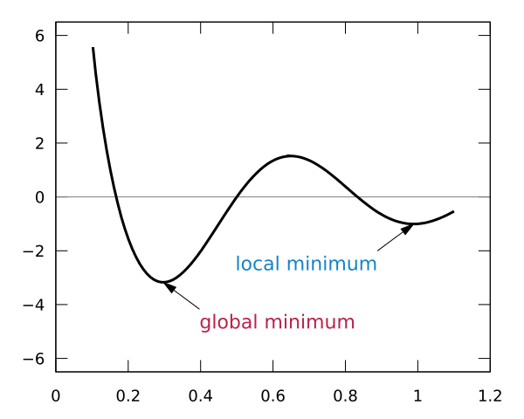
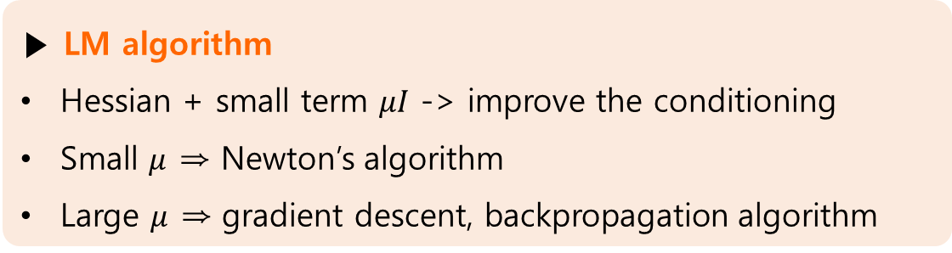
03. Modeling approach
the training speed and accuracy of error minimization are important → optimization + algorithms
Backpropagation algorithm : common algorithm ⇒ slow convergence + local minima
Newton’s method : Hessian matrix ⇒ singular (no inverse matrix)
Levenberg-Marquardt (LM) algorithm : modify the Hessian matrix
▶ LM algorithm
Hessian + small term $μI$ -> improve the conditioning
Small $μ$ ⇒ Newton’s algorithm
Large $μ$ ⇒ gradient descent, backpropagation algorithm
-12-
Notes:
Since the training speed and accuracy of error minimization are important to obtain a reliable model, optimization is key, and thus different algorithms can be employed and evaluated.
Backpropagation algorithm is a common algorithm used in ANN, but it has slow convergence and getting stuck in local minima.
For fast convergence, they used Newton’s method to train MLP, but the Hessian matrix for the hole network is singular. It means it has no inverse matrix.
So, Levenberg-Marquardt LM algorithm can overcome this problem by modifying the Hessian matrix.
The LM algorithm adds a small term $μI$ to the Hessian matrix to improve the conditioning.
Extensive research has been done in finding good initial values for $μ$.
Small values of m allow the performance to approach Newton's algorithm whereas large values of m are identical to gradient descent or backpropagation algorithm performance.
In systems with multiple minima, such as the one shown, LM is more likely to find the global minimum if the initial guess is already close to the solution.

Slide 15



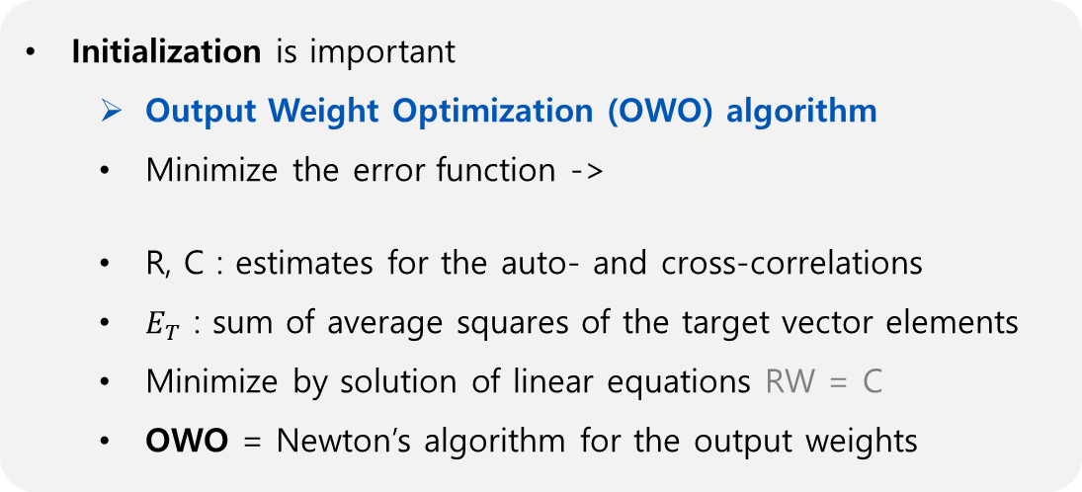
03. Modeling approach
Initialization is important
Output Weight Optimization (OWO) algorithm
Minimize the error function ->
R, C : estimates for the auto- and cross-correlations
$E_{T}$ : sum of average squares of the target vector elements
Minimize by solution of linear equations RW = C
OWO = Newton’s algorithm for the output weights
▶ OWO - Newtons algorithm
Train output weight using OWO
Train input weight using Newton’s method
Until a specified tolerance is reached or for a fixed number of iterations.
▶ Newtons algorithm
The basis of lot of second order optimization algorithms
Iterative : each iteration calculates the Newton direction d, updates variables with direction d
Vector d is calculated by solving (H : Hessian matrix, g : gradient of the objective function=error)
Variables are updated as
-13-
Notes:
Initialization is important in neural network modeling and there are several methods to do this. One simple method that can be easily used in feedforward networks is the Output Weight Optimization (OWO) algorithm. OWO minimizes the error function this,
(This paper used orthogonal least squares for R.)
where R and C are estimates for the auto- and cross-correlations of the underlying random process, and Et is sum of average squares of the target vector elements.
This Equation is minimized by the solution to the linear equations RW = C.
The owo algorithm is merely Newton’s algorithm for the output weights since this Equation is quadratic(이차방정식)
Newton’s algorithm is the basis of a lot of popular second order optimization algorithms including Levenberg-Marquardt.
Newton's algorithm is iterative where each iteration calculates the Newton direction d and updates variables with direction d.
The vector d is calculated by solving the linear equations where H is the Hessian matrix and g is the gradient of the objective function, which is the error.
The variables are then updated as ~~ . Non-quadratic objective functions results in w being updated as ~~~
OWO-Newton iteratively trains output weight using OWO and the input weights using Newton's method.
This is done until a specified tolerance is reached or for a fixed number of iterations.

Slide 16
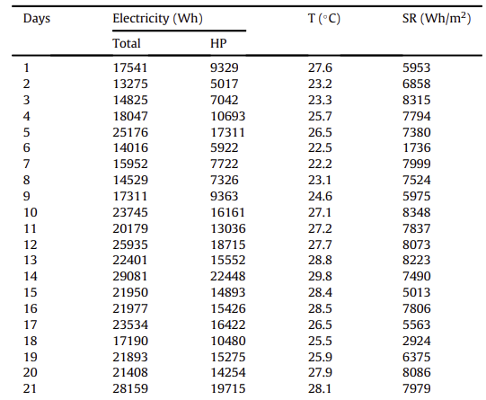
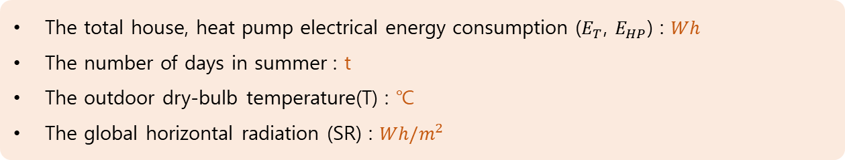
04. Experimental environment: TxAIRE research house
▶ TxAIRE Research and Demonstration House
Recorded data : energy consumption + weather parameters
During June, July, and August 2013
The house is unoccupied
All energy systems are electric (no natural gas is used)
Fully instrumented testbeds : making possible full testing and analyses of roof, wall, window, and slab building envelope components
Energy consumption is recorded every 5 min for the total electricity and HVAC equipment
Weather data is recorded every 5 min by a weather station
The total house, heat pump electrical energy consumption ($E_{T}$, $E_{HP}$) : $Wh$
The number of days in summer : t
The outdoor dry-bulb temperature(T) : ℃
The global horizontal radiation (SR) : $Wh/m^{2}$
~ 72 datasets
-14-
Notes:
The selected data used for the NN method analysis are the energy consumption and weather parameters recorded at the TxAIRE Research and Demonstration House during the months of June, July, and August 2013. The picture is a photo of the house.
The house is unoccupied, and all energy systems are electric, it means no natural gas is used.
The TxAIRE Houses are fully instrumented testbeds, making possible full testing and analyses of roof, wall, window, and slab building envelope components.
The house uses only electricity and energy consumption is recorded every 5 min for the total electricity and HVAC equipment.
Weather data is recorded also every 5 min by a weather station located at the research site.
For this analysis, the data is compiled to obtain the daily energy consumption and weather parameters given in that table.
The total (house) and the heat pump (HP) electrical energy consumptions ET and EHP are given in Wh,
the number of days in summer t, the outdoor dry-bulb temperature T is given in C and the global horizontal radiation SR is giving in Wh/m^2 .

Slide 17
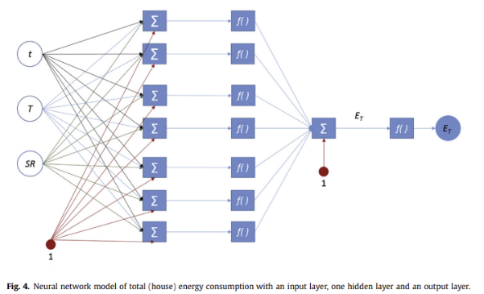
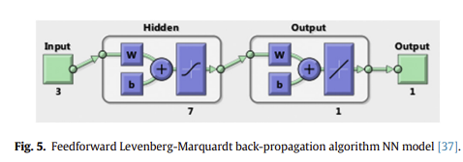
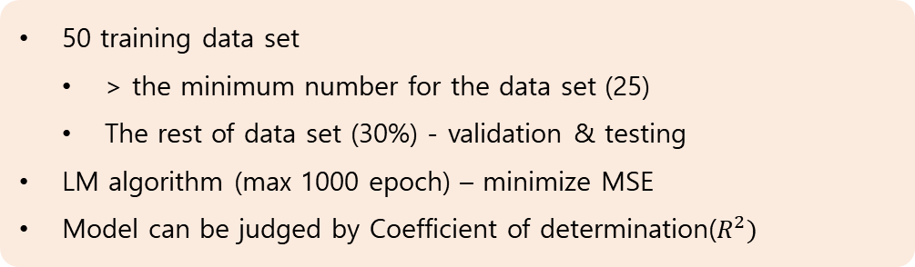
05. Results and discussion
Two NN models
Output : The total energy consumption
Another : The HP energy consumption
Input
The number of days (t)
The dry-bulb temperature (T)
The solar radiation (SR)
7 neurons in hidden layer ( )
log-sigmoid function
50 training data set
> the minimum number for the data set (25)
The rest of data set (30%) - validation & testing
LM algorithm (max 1000 epoch) – minimize MSE
Model can be judged by Coefficient of determination($R^{2})$
-15-
Notes:
They used 2 NN models. First picture illustrates the NN of the total energy consumption as the output. And the same NN is developed for another that has the HP energy consumption as output.
These two feedforward NN models are identically developed to consist of a set of input terms, a hidden layer, and an output layer. The output layer is the key distinction between the models.
Using equation we discussed before, there are 3 input variables, so the hidden layer is determined to have 7 neurons that represent the different units and systems of the house that contribute to energy consumption.
The hidden neurons are followed by log-sigmoid functions.
The responses of the hidden layer enter as inputs to the output layer of a single neuron followed by a linear function to produce the output response.
Second picture shows setup diagram of the model using in MATLAB® and its Neural Network toolbox
Based on Equation, the 50 training data set exceeds the minimum number for the data set. The rest of the data set is used for validation and testing.
Given successful use in prior studies, the LM algorithm with a maximum 1000 epoch is permitted for the training to converge the model rapidly by minimizing the MSE. The quality of fit of the model to the given target data of the house and HP energy consumptions can be judged by using the coefficient of determination R^2.

Slide 18
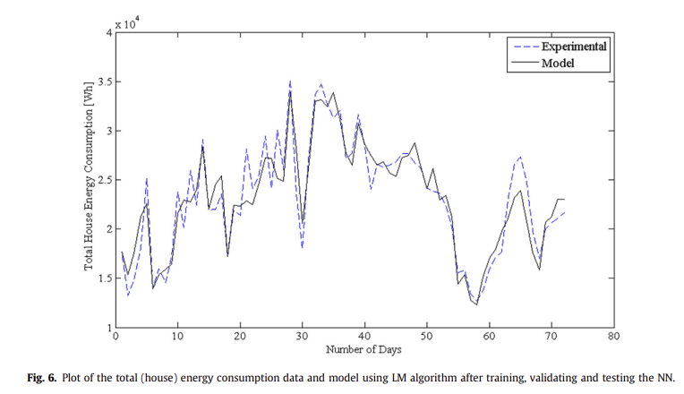
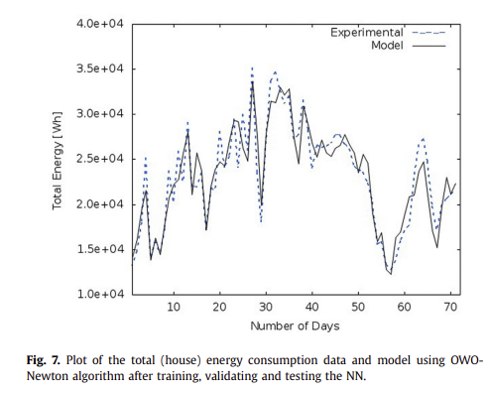
05. Results and discussion
The total energy consumption
LM algorithm
OWO-Newton algorithm
-16-
Notes:
Left picture shows the experimental data and NN model using LM algorithm of the total energy consumption over the summer days.
The x-axis is the selected number of days in summer of 2013
and the y-axis is the total energy consumption in Wh.
The dashed line is labeled as the experimental data while the solid continuous line represents the model obtained after training, validating and testing the data set.
Right picture shows the experimental data and NN model using OWO-Newton algorithm of the total energy consumption, which has the same axes and lines as before.

Slide 19
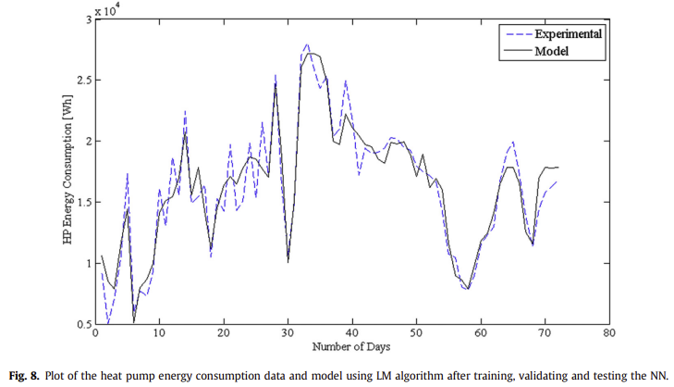
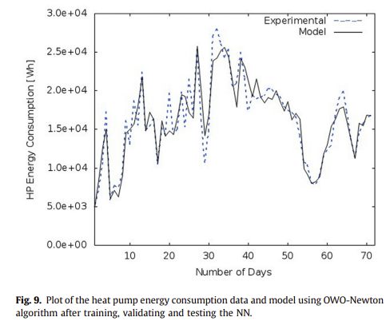
05. Results and discussion
The HP energy consumption
LM algorithm
OWO-Newton algorithm
-17-
Notes:
And these pictures shows the model using each algorithm of the HP energy consumption
which also have the same axes and lines as before.
The energy consumption for all models are in the order of 10 thousand.
The results are plotted against one input variable, the number of days for easy visual reference.

Slide 20




05. Results and discussion
The total energy consumption
The HP energy consumption
LM algorithm
LM algorithm
$R^{2}=0.878$
$R^{2}=0.906$
OWO-Newton algorithm
OWO-Newton algorithm
$R^{2}=0.87$1
$R^{2}=0.886$
-18-
Notes:
It shows the LM-based model output Et (total energy consumption) match the experimental data with R^2 of 0.878.
As shown, each coefficient of determination is 0.871, 0.906, 0.886.
The results are satisfactory and the coefficients of determination are comparable to prior studies.
The plots also illustrate the nonlinearity and fluctuations in the energy consumption.
The lower R2 and the higher nonlinearity of the house energy consumption data than those of the HP energy consumption data can be observed from the results.
Since the heat pump only accounts for a specific portion of the house, the fluctuations in energy consumption is less than that of the whole house.
In the figures of the results, one can also observe some regions where there are significant differences between the model and the data. This could be the neural network model parameters being over constrained and thus lead to larger errors in regions with more noise or more variation than expected.
The LM-based model was slightly better than the OWO-Newton-based model.
However, such comparison may not be significant due to the limited number of data points used.

Slide 21
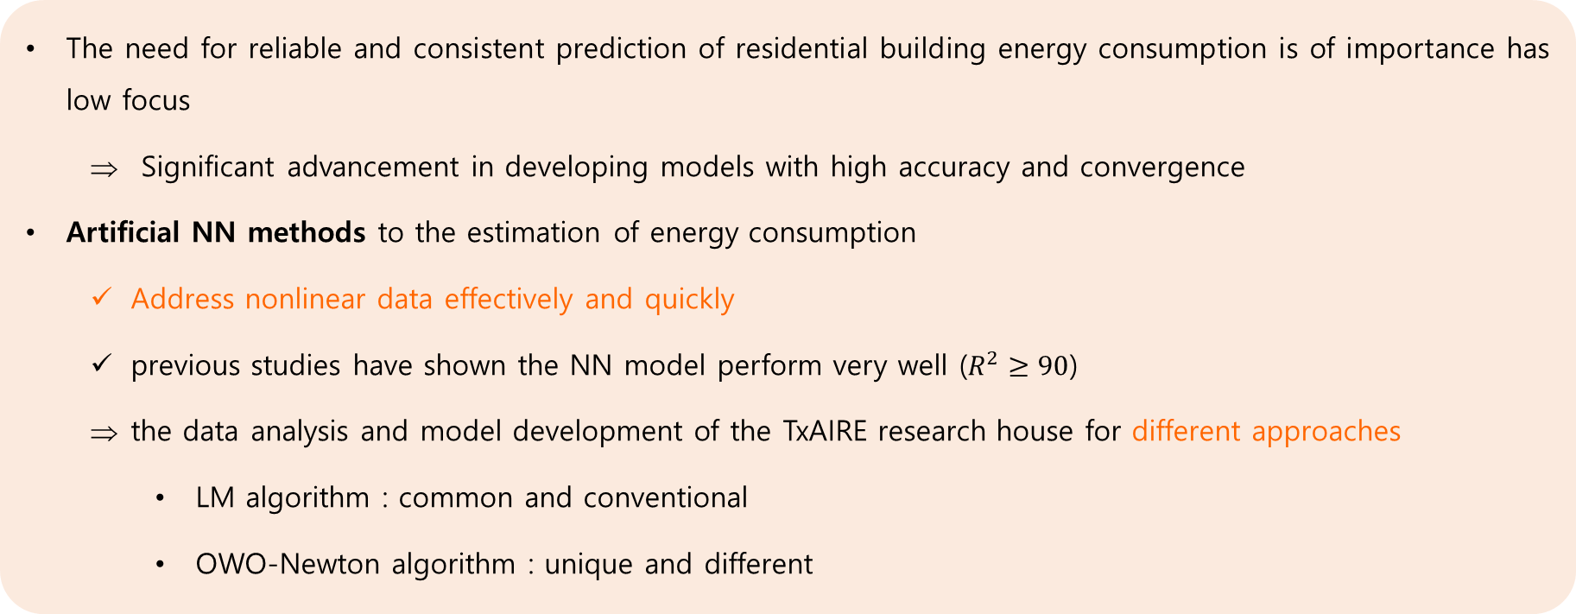
06. Concluding remarks
The need for reliable and consistent prediction of residential building energy consumption is of importance has low focus
Significant advancement in developing models with high accuracy and convergence
Artificial NN methods to the estimation of energy consumption
Address nonlinear data effectively and quickly
previous studies have shown the NN model perform very well ($R^{2}≥90$)
the data analysis and model development of the TxAIRE research house for different approaches
LM algorithm : common and conventional
OWO-Newton algorithm : unique and different
-19-
Notes:
The need for reliable and consistent prediction of residential building energy consumption is of importance, but has little focus compared to the other sectors like transportation and industry. However, recent studies has led to significant advancement in developing models with high accuracy and convergence. One such advancement has been the inclusion of artificial NN methods to the estimation of energy consumption, which typically fluctuates and is nonlinear in nature.
The NN method is able to address nonlinear data effectively and quickly using various algorithms to minimize the error including back-propagation algorithms. The results from previous studies have shown the NN models perform very well with typical coefficient of determination above 0.9. The promising results of NN models inspired the data analysis and model development of the TxAIRE research house for different approaches;
LM algorithm is common and conventional while OWO-Newton algorithm is unique and different.
The results were satisfactory for the given data set and was comparable in terms of statistical analysis with prior literature.
Further analysis will be carried with a wider range of data to assess the performance and accuracy of the NN model to predict the outputs of the TxAIRE house.

Slide 22
07. About this study
Limitation
For 3 months (June, July, August) → Data selected in one weather (summer)
72 datasets → Used small data points
The house is unoccupied → The influence of behavior and preferences of occupants is not present in recorded data
Future research
Wider range of data → assess the performance and accuracy of the NN model
More data points → improved accuracy of NN in residential building energy application
Include controlled loads due to occupancy → how the individual load
-20-
Notes:
There are few limitations in this study.
First, dataset is collected during 3 months in summer.
Also, there are only 72 datasets which is small.
And the house is unoccupied of the influence of behavior and preferences of occupants is not present in recorded data.
Future research will include with a wider range of data to assess the performance and accuracy of the NN model to predict the outputs of the TxAIRE house.
Also, more data points will be collected for improved accuracy and further analysis of NN in residential building energy application.
And future research will include controlled loads due to occupancy to investigate how the individual loads impose modifications on the NN models.
This is the end of the presentation. Thank you!

